Slide 1
GUI Concept #2

Slide 2








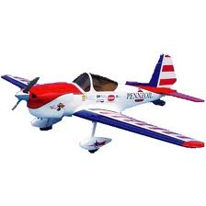

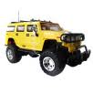


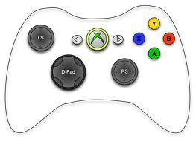

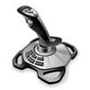


Settings
Upload Profile File from Re-Mote
Download Profile File to Re-Mote
Save Profile File
NORMAL MODE
Open Profile File
Delete Profile
New Profile
Re-Mote
GUI v.1
Profiles
Unmanned System Window
Selected Output
Profile 1
Profile 2
Profile 3
Active Profile
Unavailable System
Active System
Assignment Button
Functions
Controller Window
Active Controller
PITCH
YAW
ROLL
THROTTLE
Active MAVLink Function
Unavailable Controllers
Gain
Refresh Available Controllers
Trim
Gain/Trim Settings (Analog Control)
Selected Input

Slide 3
Settings
Upload Profile File
Download Profile File
Save Profile File
ADVANCED MODE
Open Profile File
Delete Profile
New Profile
Re-Mote
GUI v.1
Profiles
Controller Window
Profile 1
Profile 2
Profile 3
A Button…………………………………GPS HOLD
B Button…………………………………TAKEOFF
Left Axis………………………………….YAW: (255-x)/10
Active Profile
Scaling
MAVLink Function
Controller Input
Assignment Button
Functions
PITCH
YAW
ROLL
THROTTLE
Active Controller
Active MAVLink Function
Unavailable Controllers
Refresh Available
Controllers and Inputs

